Slide 1
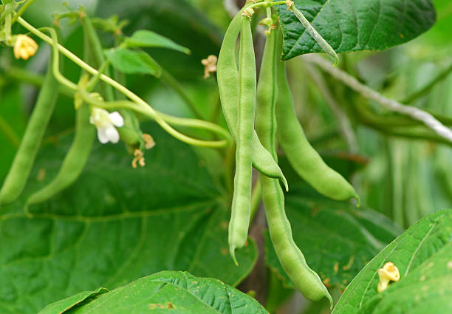





BeanCare
A Comprehensive Agricultural Intelligence Platform For Beans
Progress Review 1 (50% Completion) Stage
2023 - 24 - 103
6/11/2023

Slide 2
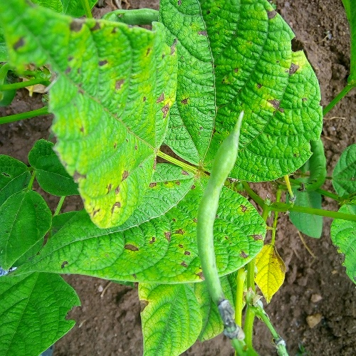
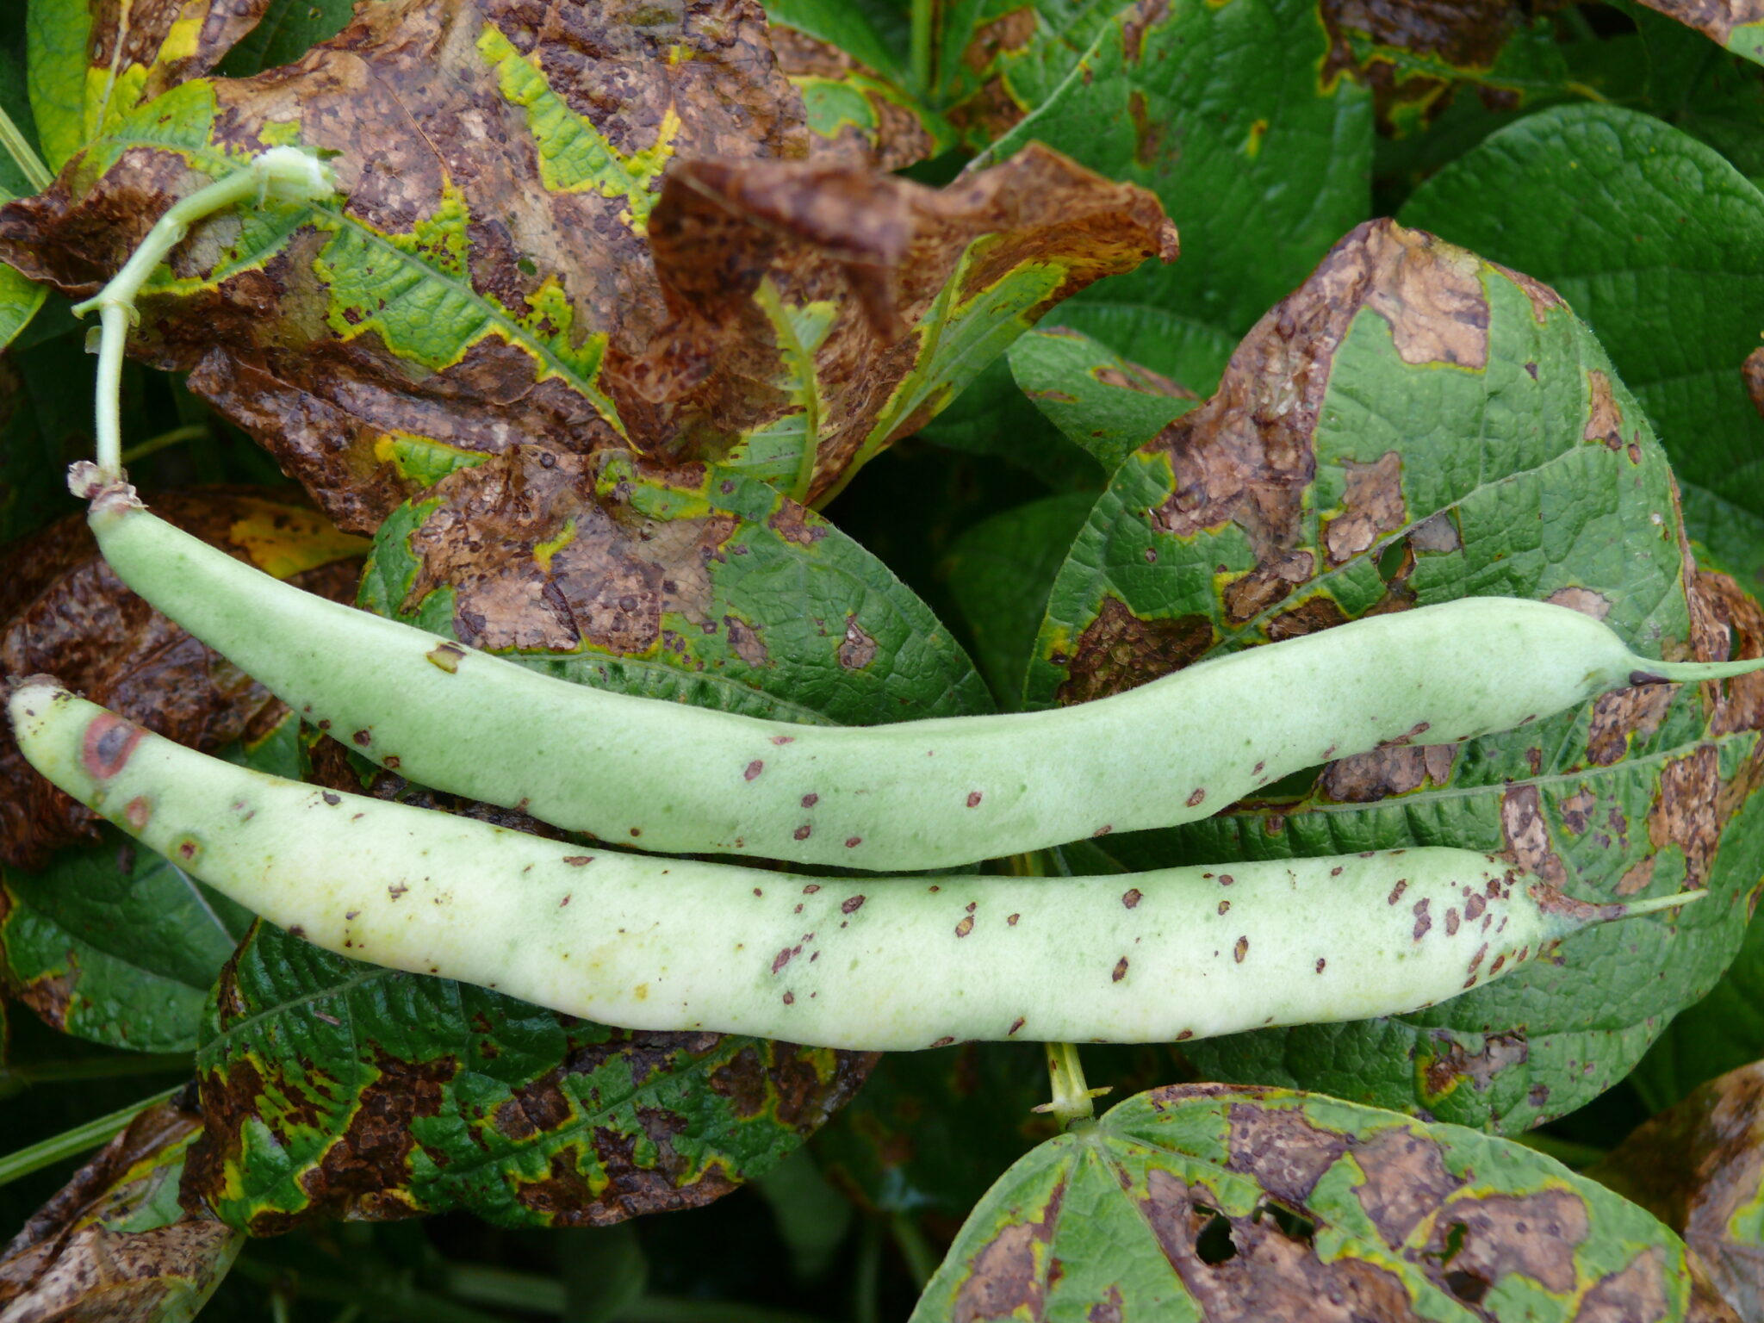

OVERALL PROJECT DESCRIPTION
According to the "2022 Sri Lanka Agriculture Census"
131,135 Farmers in Sri lanka.
In 2022, Sri Lanka exported 2,500 metric tons of green beans, worth US$3.5 million
Bean diseases in Sri Lanka can have a significant impact on farmers, causing yield losses, reduced quality, and increased costs.
A smart solution for the Beans industry
6/11/2023

Slide 3



RESEARCH PROBLEM
How to Enhance Disease Diagnosis for Bean Pods?
How to Enhance Disease Diagnosis for Bean Pods Bean Leaves?
How to Predict the Market Prices of Beans?
How to plan planting, irrigation, and harvesting schedules, ensuring beans grow under optimal climatic conditions.?
6/11/2023

Slide 4




RESEARCH OBJECTIVES
Sub Objectives
Accurate Diagnosis of Bean Leaf Diseases
Precision Diagnosis of Bean Pod Diseases
Main Objective
A Comprehensive Agricultural Intelligence Platform for Beans
Market Price Prediction for Beans
Weather Forecasting in Bean Growing Areas
6/11/2021

Slide 5
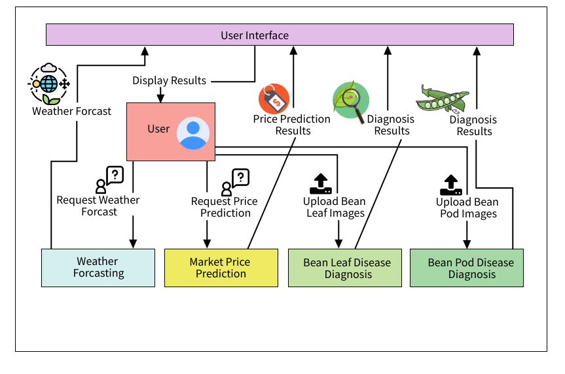
System Diagram
3/8/2021

Slide 6

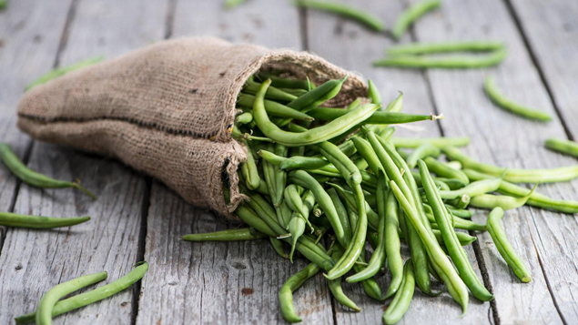
IT20647100 | Perera M.T.G.E
Specialization :Information Technology
IT20647100 | Perera M.T.G.E | 2023 - 24 - 103
3/8/2021

Slide 7
Introduction
Background
• Detection and timely diagnosis of crop diseases are vital for agricultural productivity and farmers' livelihoods.
• Agricultural regions like Sri Lanka heavily rely on bean cultivation for economic sustenance.
• Plant diseases pose a significant threat to crop yields and farmers' income in these regions.
• Conventional disease identification methods involve manual visual inspection by experts.
• Challenges include high costs, time-consuming processes, and limited scalability of these manual approaches.
IT20647100 | Perera M.T.G.E | 2023 - 24 - 103
6/11/2023

Slide 8


Introduction
Research Question
"How can machine learning techniques be effectively employed to diagnose diseases in bean pods, considering their distinctive characteristics, with the goal of providing farmers accurate and timely diagnostic tools for efficient disease management and ensuring sustained crop yield?"
IT20647100 | Perera M.T.G.E | 2023 - 24 - 103
6/11/2023

Slide 9



Introduction
Specific and Sub Objective
Data Collection and Preparation
Develop an accurate and efficient machine learning-based model for diagnosing diseases in bean pods.
Model Development and Training
Validation and Performance Assessment
User Interface Development and User Training
IT20647100 | Perera M.T.G.E | 2023 - 24 - 103
6/11/2023

Slide 10
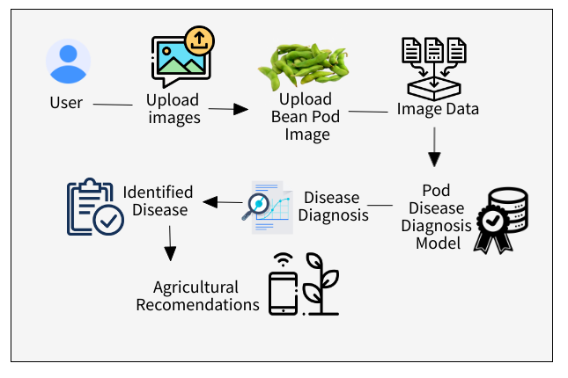
Methodology
System Diagram
IT20647100 | Perera M.T.G.E | 2023 - 24 - 103
6/11/2023

Slide 11











Used Techniques and Technologies
Techniques
Technologies
Transfer learning
Data Augmentation
Normalization
Regularization
Algorithm tuning
React Native
Python
TensorFlow
Flask Server
Node Server
Jupyter Notebook
Google Colab
Intellij Idea
Keras
IT20647100 | Perera M.T.G.E | 2023 – 24 – 103
6/11/2023

Slide 12





Methodology
Evidence of Completion
Tuning hyper-parameters and retrained models to select the best architecture
Data collection
Data pre-processing
Data Visualization
Used transfer learning based Convolutional Neural Network(CNN) architectures for training models
Host the finalized model in the flask server
Data augmentation and selected the best technique to retrain models to achieve good fitting
IT20647100 | Perera M.T.G.E | 2023 - 24 - 103
6//2023

Slide 13
Functional, Non-Functional and Personnel Requirements
Functional Requirements
Non-Functional Requirements
• Image Upload Functionality.
• Disease Detection Algorithm. • User Interface for Results.
• Integration with Backend
Accuracy and Reliability
Scalability
Security
Response Time
IT20647100 | Perera M.T.G.E | 2023 - 24 - 103
6/11/2023

Slide 14


Completion and Future works
Completion of the components
Developed and trained a robust machine learning model specifically designed for diagnosing diseases in bean pods.
………………………………………………………………..
…………………………………………………………………………
Future Implementations
Investigate and implement advanced computer vision techniques to improve disease detection.
IT20647100 | Perera M.T.G.E | 2023 - 24 - 103
6/11/2023

Slide 15
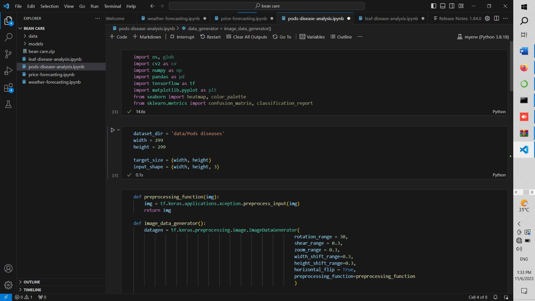
Model
Developed and trained a robust machine learning model specifically designed for diagnosing diseases in bean pods.
………………………………………………………………..
…………………………………………………………………………
IT20647100 | Perera M.T.G.E | 2023 - 24 - 103
6/11/2023

Slide 16
References
• Seneviratne, H. M. N. K., & Premarathne, W. M. J. K. (2017). Automatic Pest Detection in Paddy Leaves using Image Processing Techniques. In Proceedings of the International Research Conference on Smart Computing and Systems Engineering (SCSE) (pp. 119-124). IEEE.
• Samarasekara, G., Perera, R., & De Silva, K. (2019). Automated Pest Detection in Rice Plant Leaves using Image Processing Techniques. In Proceedings of the 2019 IEEE International Conference on Industrial Engineering and Engineering Management (IEEM) (pp. 1702-1706). IEEE.
• Kodagoda, D. K., Hewavithana, P. G. A., & Premaratne, H. (2017). Development of a Decision Support System for Pest and Disease Management in Rice Production in Sri Lanka. In Proceedings of the 10th International Conference on Information and Automation for Sustainability (ICIAfS) (pp. 1-5). IEEE.
• Tharanga, A. G. H. D., Edirisinghe, E. A. S., & Nanayakkara, S. A. P. (2018). Detection of Common Diseases in Papaya using Image Processing Techniques. In Proceedings of the 2018 IEEE International Conference on Advanced Robotics and its Social Impacts (ARSO) (pp. 64-69). IEEE.
• Ratnaweera, R. A. D. C., Wijayakulasooriya, J. V. S. R., & Senarath, A. D. (2020). Detection of Banana Diseases Using Deep Learning Techniques. In Proceedings of the 2020 IEEE International Conference on Big Data and Smart Computing (BigComp) (pp. 53-57). IEEE.
IT20647100 | Perera M.T.G.E | 2023 - 24 - 103
6/11/2023

Slide 17
IT20299170 | Subasinghe H.K.A.A.S
Specialization :Information Technology
IT20299170 | Subasinghe H.K.A.AS | 2023 - 24 - 103
3/8/2021

Slide 18
Introduction
Background
• Critical Agricultural Need:
Timely disease detection vital for agriculture, especially in bean-centric economies like Sri Lanka.
• Manual Inspection Challenges:
Manual leaf inspection laborious, time-consuming, and prone to errors.
• Demand for Advanced System:
Urgent need for precise disease diagnosis system using modern machine learning techniques.
• Technology Empowerment:
Implementation of advanced algorithms empowers farmers with accurate and timely solutions.
IT20299170 | Subasinghe H.K.A.AS | 2023 - 24 - 103
6/11/2023

Slide 19



Research Question
?
"How can image preprocessing techniques and suitable CNN architectures be optimized to develop an efficient Disease Diagnosis System for accurately identifying and classifying different bean leaf diseases?"
2
3
IT20299170 | Subasinghe H.K.A.AS | 2023 - 24 - 103
6/11/2023

Slide 20

Specific and Sub Objective
Optimize Image Preprocessing Techniques
Specific Objective
Explore and Select Optimal CNN Architecture
Develop an advanced Disease Diagnosis System for accurate classification of various bean leaf diseases using machine learning techniques.
Develop and Implement Effective Training Strategies
Evaluate and Fine-Tune Model Performance
IT20299170 | Subasinghe H.K.A.AS | 2023 - 24 - 103
6/11/2023

Slide 21
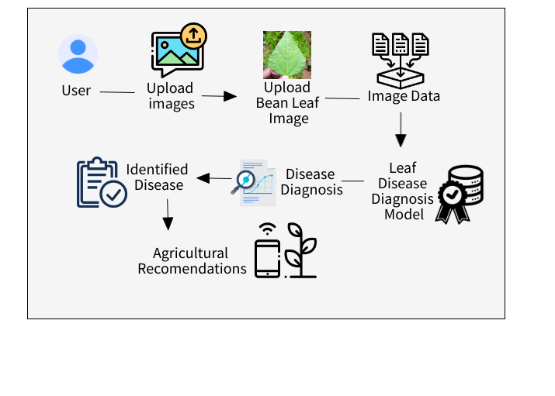
Methodology
System Diagram
IT20299170 | Subasinghe H.K.A.AS | 2023 - 24 - 103
6/11/2023

Slide 22

Used Techniques and Technologies
Techniques
Technologies
Transfer learning
Data Augmentation
Normalization
Regularization
Algorithm tuning
React Native
Python
TensorFlow
Flask Server
Node Server
Jupyter Notebook
Google Colab
Intellij Idea
Keras
IT20299170 | Subasinghe H.K.A.AS | 2023 - 24 - 103
6/11/2023

Slide 23



Methodology
Completion of the project
Data Collection
Data Pre Processing and Create Data Set With Data Augmentation
Test Trained Model Architectures using validation data
Used transfer learning based Convolutional Neural Network(CNN) architectures for training models
Data visualization and Tuning hyper-parameters and retrained models to select the best architecture
IT20299170 | Subasinghe H.K.A.AS | 2023 - 24 - 103
3/8/2021

Slide 24

Completion and Future works
Future Implementations
Completion of the components
Research and implement transfer learning techniques to adapt the model for different bean plant varieties and growing conditions.
Developed and trained a specialized machine learning model for diagnosing diseases in bean leaves.
IT20299170 | Subasinghe H.K.A.AS | 2023 - 24 - 103
6/11/2023

Slide 25
Functional, Non-Functional and Personnel Requirements
Functional Requirements
Non-Functional Requirements
Advanced Image Preprocessing.
Disease Classification Algorithm.
User-Friendly Interface for Diagnosis.
Integration with Backend Services.
Accuracy and Reliability
Scalability
Security
Response Time
IT20299170 | Subasinghe H.K.A.AS | 2023 - 24 - 103
6/11/2023

Slide 26
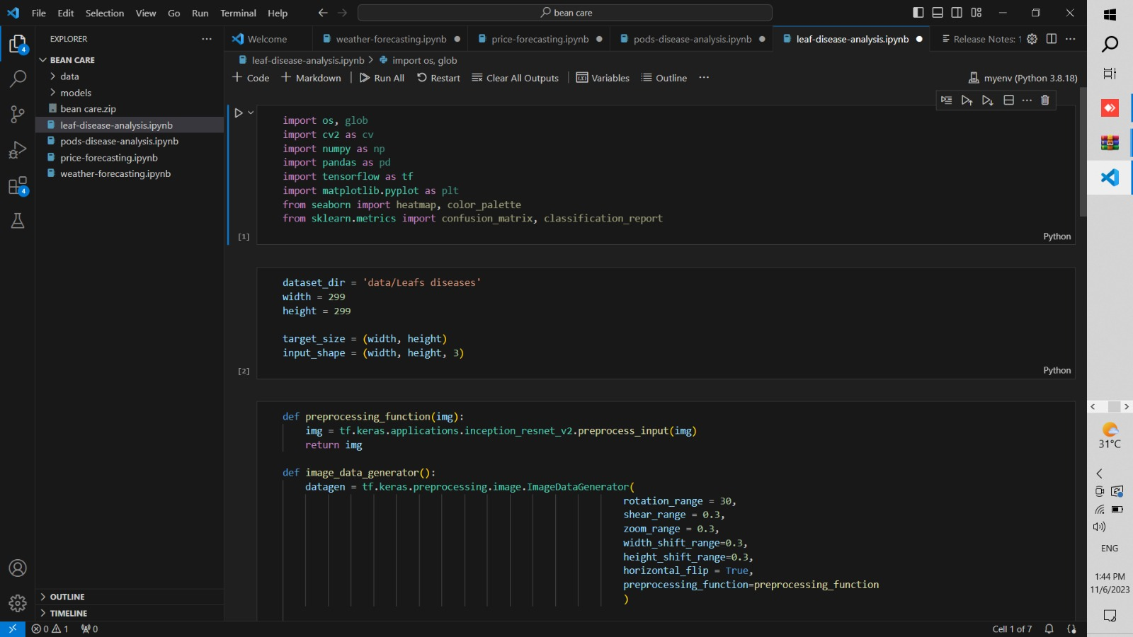
Model
Developed and trained a robust machine learning model specifically designed for diagnosing diseases in bean pods.
………………………………………………………………..
…………………………………………………………………………
IT20299170 | Subasinghe H.K.A.AS | 2023 - 24 - 103
6/11/2023

Slide 27
References
• Seneviratne, H. M. N. K., & Premarathne, W. M. J. K. (2017). Automatic Pest Detection in Paddy Leaves using Image Processing Techniques. In Proceedings of the International Research Conference on Smart Computing and Systems Engineering (SCSE) (pp. 119-124). IEEE.
• Samarasekara, G., Perera, R., & De Silva, K. (2019). Automated Pest Detection in Rice Plant Leaves using Image Processing Techniques. In Proceedings of the 2019 IEEE International Conference on Industrial Engineering and Engineering Management (IEEM) (pp. 1702-1706). IEEE.
• Kodagoda, D. K., Hewavithana, P. G. A., & Premaratne, H. (2017). Development of a Decision Support System for Pest and Disease Management in Rice Production in Sri Lanka. In Proceedings of the 10th International Conference on Information and Automation for Sustainability (ICIAfS) (pp. 1-5). IEEE.
• Tharanga, A. G. H. D., Edirisinghe, E. A. S., & Nanayakkara, S. A. P. (2018). Detection of Common Diseases in Papaya using Image Processing Techniques. In Proceedings of the 2018 IEEE International Conference on Advanced Robotics and its Social Impacts (ARSO) (pp. 64-69). IEEE.
• Ratnaweera, R. A. D. C., Wijayakulasooriya, J. V. S. R., & Senarath, A. D. (2020). Detection of Banana Diseases Using Deep Learning Techniques. In Proceedings of the 2020 IEEE International Conference on Big Data and Smart Computing (BigComp) (pp. 53-57). IEEE.
IT20299170 | Subasinghe H.K.A.AS | 2023 - 24 - 103
6/11/2023

Slide 28
IT20119362 | Bandara Higgoda T.T.S
Specialization :Information Technology
IT20119362 | Bandara Higgoda T.T.S | 2023 - 24 - 103
3/8/2021

Slide 29
Introduction
Background
• Accurate prediction of market value for beans is vital for informed decision-making among farmers in Sri Lanka.
• Historical data on bean prices from local markets and trading platforms offers valuable insights into market trends.
• Developing a predictive model for market value estimation empowers farmers with a better understanding of bean market dynamics.
• The aim is to enable farmers to make strategic choices regarding their crop sales and enhance their overall economic sustainability.
IT20119362 | Bandara Higgoda T.T.S | 2023 - 24 - 103
6/11/2023

Slide 30

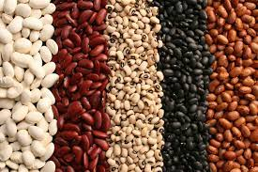
Introduction
Research Question
"How can historical market data and predictive modeling techniques be utilized to accurately forecast bean prices in Sri Lanka, empowering farmers with valuable insights for informed decision-making in crop sales?"
IT20119362 | Bandara Higgoda T.T.S | 2023 - 24 - 103
6/11/2023

Slide 31
Introduction
Specific and Sub Objectives
Sub Objectives
• Data Collection and Preparation:
Gather comprehensive historical data on bean prices from local markets and trading platforms in Sri Lanka.
• Exploratory Data Analysis (EDA):
Conduct exploratory data analysis to identify patterns, trends, and factors influencing bean prices.
• Feature Selection and Engineering:
Identify relevant features from the dataset that significantly impact bean prices.
• Model Development and Evaluation
• Deployment and Monitoring
Specific Objective
"Develop a predictive model for bean market price estimation in Sri Lanka using historical data and advanced data analysis techniques."
IT20119362 | Bandara Higgoda T.T.S | 2023 - 24 - 103
6/11/2023

Slide 32
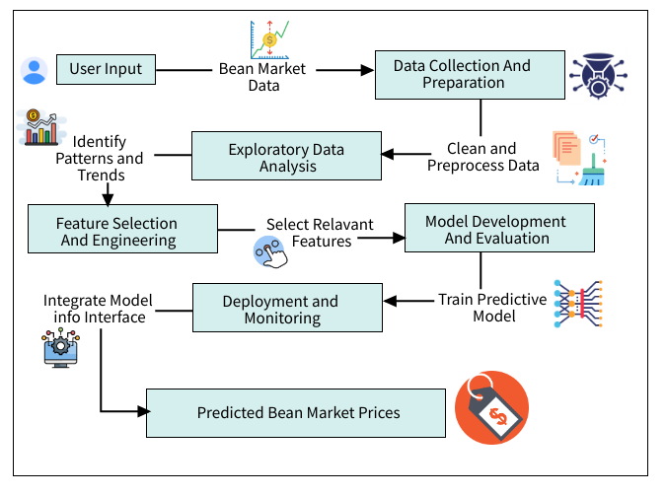
Methodology
System Diagram
IT20119362 | Bandara Higgoda T.T.S | 2023 - 24 - 103
6/11/2023

Slide 33





Technologies and Architectures Used
Technologies and Libraries
Architectures
Python
Pandas
TensorFlow
React
Express.js
MongoDB
React Native
Flask
Matplotlib
Seaborn
CNN
Pandas and NumPy
IT20119362 | Bandara Higgoda T.T.S | 2023 - 24 - 103
6/11/2023

Slide 34
Methodology
Completion of the project
Data Collection
Data Pre Processing and Create Data Set With Data Augmentation
Test Trained Model Architectures using validation data
Used transfer learning based Convolutional Neural Network(CNN) architectures for training models
Data visualization and Tuning hyper-parameters and retrained models to select the best architecture
IT20119362 | Bandara Higgoda T.T.S | 2023 - 24 - 103
6/11/2023

Slide 35
Completion and Future works
Future Implementations
Completion of the components
Implement sentiment analysis techniques on social media and market news to gauge public perception, influencing market prices.
Developed and trained a predictive machine learning model for forecasting bean market prices based on historical and real-time data.
…………………………
IT20119362 | Bandara Higgoda T.T.S | 2023 - 24 - 103
6/11/2023

Slide 36
Functional, Non-Functional and Personnel Requirements
Functional Requirements
Non-Functional Requirements
• Data Collection:
Retrieve historical bean market data from local markets and trading platforms.
• Data Processing and Analysis:
Cleanse and preprocess the collected data for analysis.
• Prediction and Recommendation:
Develop a predictive model to estimate bean market prices accurately.
Accuracy and Reliability
Scalability
Security
Response Time
IT20119362 | Bandara Higgoda T.T.S | 2023 - 24 - 103
6/11/2023

Slide 37
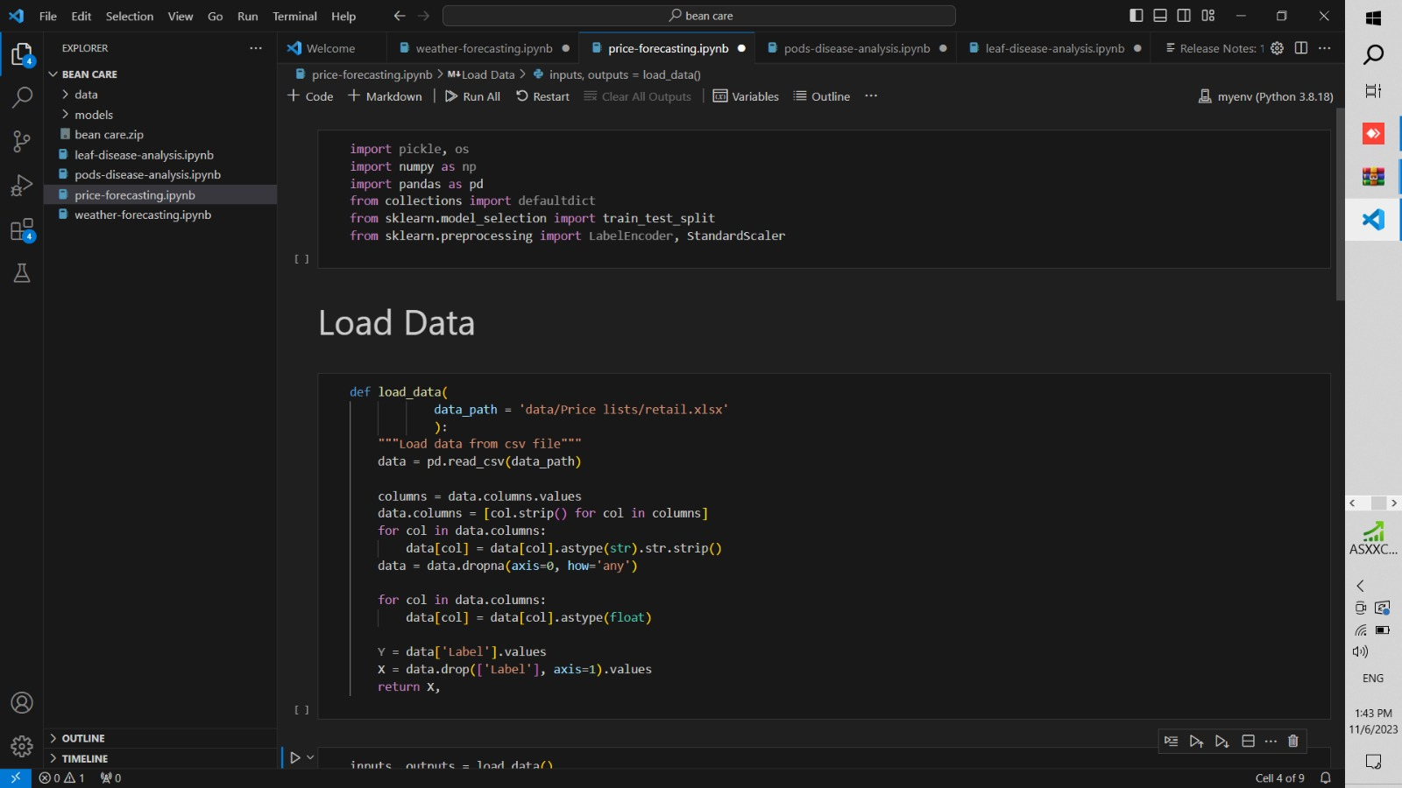
Model
Developed and trained a robust machine learning model specifically designed for diagnosing diseases in bean pods.
………………………………………………………………..
…………………………………………………………………………
IT20119362 | Bandara Higgoda T.T.S | 2023 - 24 - 103
6/11/2023

Slide 38
References
• Seneviratne, H. M. N. K., & Premarathne, W. M. J. K. (2017). Automatic Pest Detection in Paddy Leaves using Image Processing Techniques. In Proceedings of the International Research Conference on Smart Computing and Systems Engineering (SCSE) (pp. 119-124). IEEE.
• Samarasekara, G., Perera, R., & De Silva, K. (2019). Automated Pest Detection in Rice Plant Leaves using Image Processing Techniques. In Proceedings of the 2019 IEEE International Conference on Industrial Engineering and Engineering Management (IEEM) (pp. 1702-1706). IEEE.
• Kodagoda, D. K., Hewavithana, P. G. A., & Premaratne, H. (2017). Development of a Decision Support System for Pest and Disease Management in Rice Production in Sri Lanka. In Proceedings of the 10th International Conference on Information and Automation for Sustainability (ICIAfS) (pp. 1-5). IEEE.
• Tharanga, A. G. H. D., Edirisinghe, E. A. S., & Nanayakkara, S. A. P. (2018). Detection of Common Diseases in Papaya using Image Processing Techniques. In Proceedings of the 2018 IEEE International Conference on Advanced Robotics and its Social Impacts (ARSO) (pp. 64-69). IEEE.
• Ratnaweera, R. A. D. C., Wijayakulasooriya, J. V. S. R., & Senarath, A. D. (2020). Detection of Banana Diseases Using Deep Learning Techniques. In Proceedings of the 2020 IEEE International Conference on Big Data and Smart Computing (BigComp) (pp. 53-57). IEEE.
IT20119362 | Bandara Higgoda T.T.S | 2023 - 24 - 103
6/11/2023

Slide 39
IT20249502 | Devinda K.K.D
Specialization :Information Technology
IT20249502 | Devinda K.K.D | 2023 - 24 - 103
3/8/2021

Slide 40
Introduction
Background
• Accurate weather prediction is essential for effective disease management in Sri Lanka's bean crops.
• Weather elements such as temperature, humidity, and precipitation have a significant impact on disease outbreaks.
• Developing a predictive model specifically tailored to bean-growing regions is crucial.
• The model will provide invaluable support to farmers, enabling them to optimize their agricultural practices.
IT20249502 | Devinda K.K.D | 2023 - 24 - 103
6/11/2023

Slide 41
Introduction
Research Question
"How can accurate weather condition prediction models be developed and utilized to optimize disease management strategies for bean crops in Sri Lanka?"
IT20249502 | Devinda K.K.D | 2023 - 24 - 103
6/11/2023

Slide 42
Introduction
Specific and Sub Objective
Data Collection and Analysis
Develop a comprehensive weather prediction model tailored to bean-growing regions in Sri Lanka.
Model Development
Validation and Calibration
Integration and User Interface
IT20249502 | Devinda K.K.D | 2023 - 24 - 103
6/11/2023

Slide 43
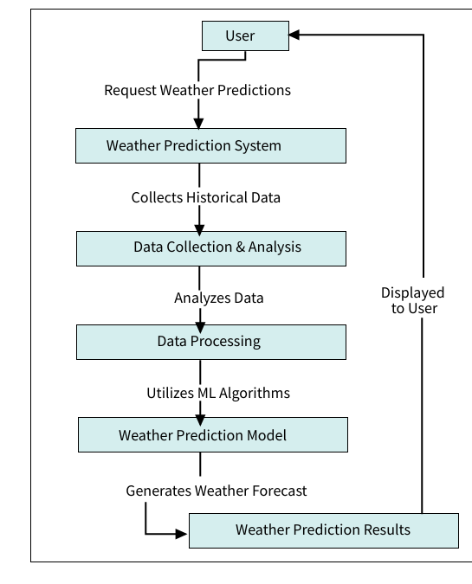
Methodology
System Diagram
IT20249502 | Devinda K.K.D | 2023 - 24 - 103
6/11/2023

Slide 44
Technologies and Architectures Used
Technologies and Libraries
Architectures
Python
Pandas
TensorFlow
React
Express.js
MongoDB
React Native
Flask
Matplotlib
Seaborn
CNN
Pandas and NumPy
IT20249502 | Devinda K.K.D | 2023 - 24 - 103
6/11/2023

Slide 45
Methodology
Evidence of Completion
Tuning hyper-parameters and retrained models to select the best architecture
Data collection
Data pre-processing
Used transfer learning based Convolutional Neural Network(CNN) architectures for training models
Data augmentation and selected the best technique to retrain models to achieve good fitting
IT20249502 | Devinda K.K.D | 2023 - 24 - 103
6//2023

Slide 46
Functional, Non-Functional and Personnel Requirements
Functional Requirements
Non-Functional Requirements
• Weather Data Collection.
• Data Analysis.
• Machine Learning Integration.
• Forecast Generation.
Accuracy and Reliability
Scalability
Security
Response Time
IT20249502 | Devinda K.K.D | 2023 - 24 - 103
6/11/2023

Slide 47
Completion and Future works
Completion of the components
Developed and trained a specialized weather prediction model focused on bean crop cultivation areas in Sri Lanka.
Future Implementations
Explore the integration of IoT devices for real-time weather data collection, ensuring the model's continuous validation and improvement.
IT20249502 | Devinda K.K.D | 2023 - 24 - 103
6/11/2023

Slide 48
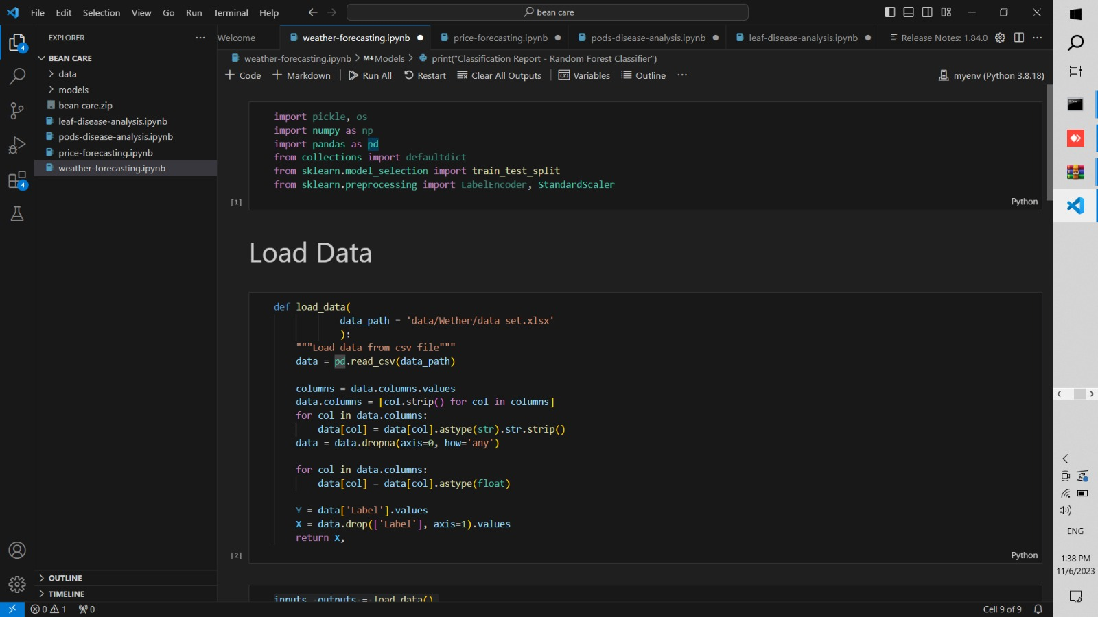
Model
Developed and trained a robust machine learning model specifically designed for diagnosing diseases in bean pods.
………………………………………………………………..
…………………………………………………………………………
IT20249502 | Devinda K.K.D | 2023 - 24 - 103
6/11/2023

Slide 49
References
• Seneviratne, H. M. N. K., & Premarathne, W. M. J. K. (2017). Automatic Pest Detection in Paddy Leaves using Image Processing Techniques. In Proceedings of the International Research Conference on Smart Computing and Systems Engineering (SCSE) (pp. 119-124). IEEE.
• Samarasekara, G., Perera, R., & De Silva, K. (2019). Automated Pest Detection in Rice Plant Leaves using Image Processing Techniques. In Proceedings of the 2019 IEEE International Conference on Industrial Engineering and Engineering Management (IEEM) (pp. 1702-1706). IEEE.
• Kodagoda, D. K., Hewavithana, P. G. A., & Premaratne, H. (2017). Development of a Decision Support System for Pest and Disease Management in Rice Production in Sri Lanka. In Proceedings of the 10th International Conference on Information and Automation for Sustainability (ICIAfS) (pp. 1-5). IEEE.
• Tharanga, A. G. H. D., Edirisinghe, E. A. S., & Nanayakkara, S. A. P. (2018). Detection of Common Diseases in Papaya using Image Processing Techniques. In Proceedings of the 2018 IEEE International Conference on Advanced Robotics and its Social Impacts (ARSO) (pp. 64-69). IEEE.
• Ratnaweera, R. A. D. C., Wijayakulasooriya, J. V. S. R., & Senarath, A. D. (2020). Detection of Banana Diseases Using Deep Learning Techniques. In Proceedings of the 2020 IEEE International Conference on Big Data and Smart Computing (BigComp) (pp. 53-57). IEEE.
IT20249502 | Devinda K.K.D | 2023 - 24 - 103
6/11/2023

